Slide 1
EUE · UNIVERSITY PROJECT
Smart
University
Making availability visible before the search begins.
Parking System
A smarter parking experience at EUE
PROJECT PRESENTATION
Presented by: Mohamed, Muhannad, Mahmoud, Malak, Mariam & Joyce
SMART PARKING

Slide 2




01 · THE PROBLEM
Parking is a daily coordination problem
Unclear availability
Time and congestion
Students and staff may struggle to identify an available space before entering the parking area.
Searching for a space wastes time and can create avoidable vehicle congestion.
Frustration and conflict
The opportunity
Unclear availability can increase frustration and the potential for conflicts between drivers.
Make parking information visible before the search begins.

Slide 3
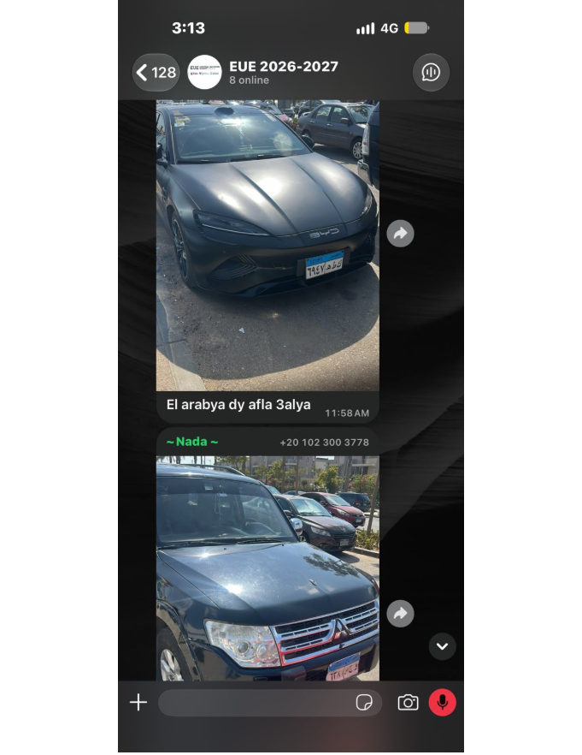
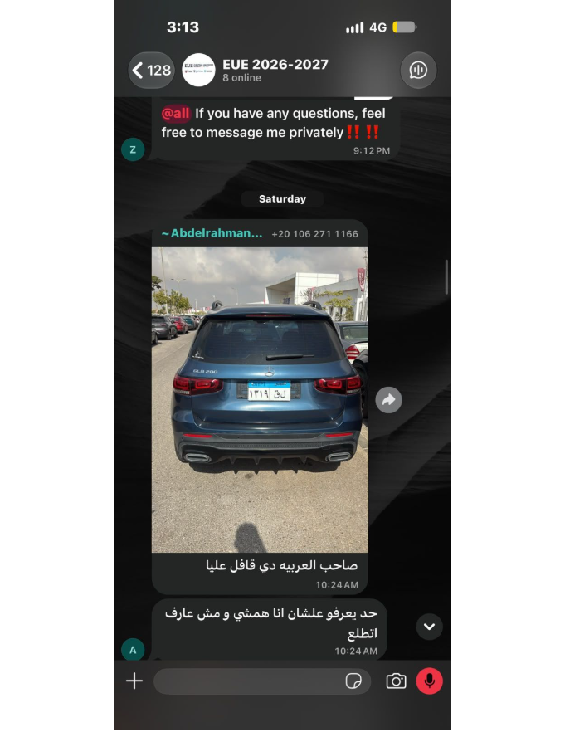
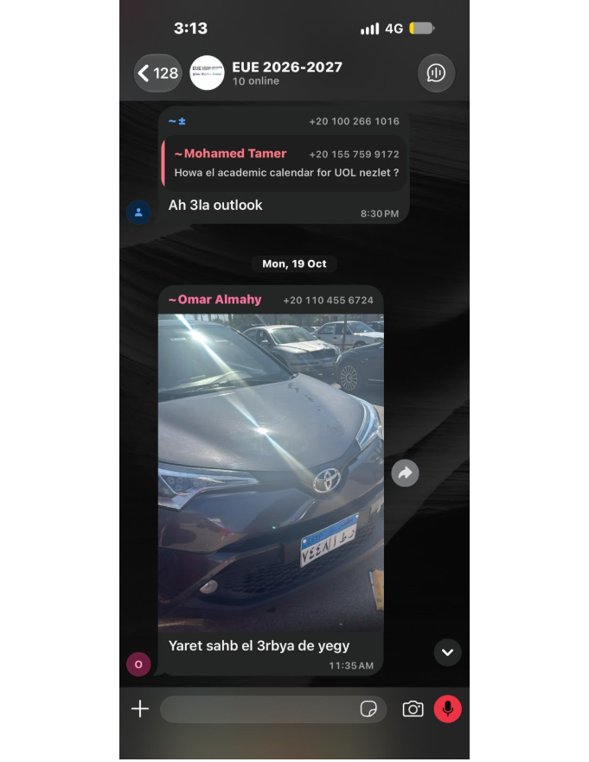
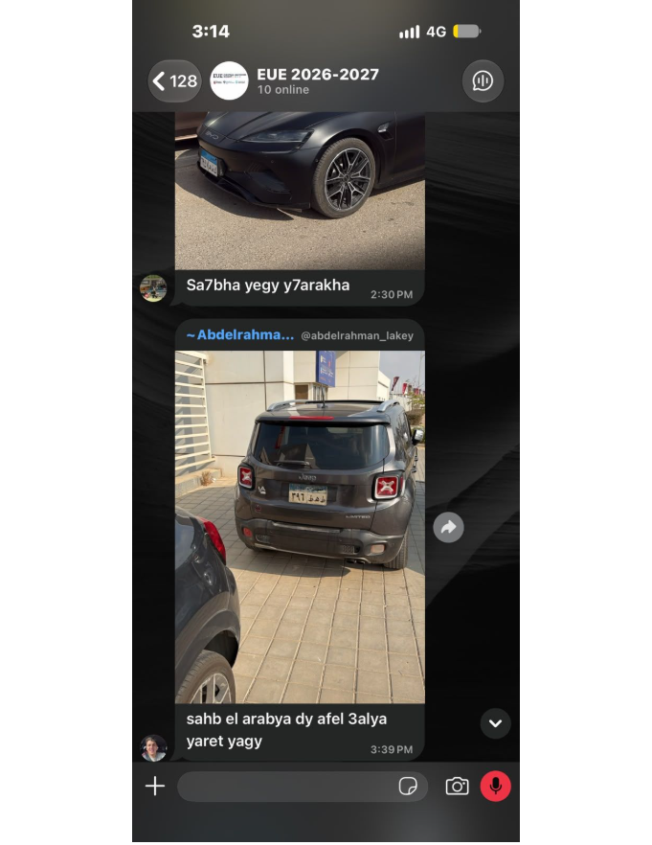
02 · REAL EVIDENCE
The university community is already raising the issue
Student-submitted parking photos from the EUE community group connect the project to a real university environment.
Student-submitted parking photos — examples from the university parking environment. These images establish context, not occupancy statistics.

Slide 4




03 · THE PROPOSED SOLUTION
Smart Parking makes availability visible
Detect
Identify
Transmit
Decide
Parking spaces are monitored using sensors or cameras.
The system identifies whether spaces are occupied or available.
Availability information is transmitted to a mobile application.
Users see a simple map: green for available, red for occupied.
Potential benefits: less searching, smoother traffic flow, better organization, and a more convenient university experience.

Slide 5




04 · THE USER EXPERIENCE
A simple interface can shorten the search
Live display
Visual map
Clear decisions
Live parking availability display.
Visual parking map with green and red indicators.
Clear, accessible interface for quick decisions.
Conceptual interface only: this is a proposed design, not an implemented product.

Slide 6
05 · FEASIBILITY
Start with a manageable prototype
01
02
03
Initial prototype
System development
Future expansion
Design the interface, create a simulated parking map, and display sample availability data.
Build the core functionality, connect an availability data source, and test updates.
Integrate real sensors or cameras, improve detection accuracy, and extend coverage.
The project can demonstrate its main function before requiring complete real-world infrastructure.

Slide 7
How students use it
Upload university lecture materials
Get simplified explanations of the content
Ask questions about difficult topics
Practice with quizzes
06 · SECOND IDEA
AI-Powered Learning Platform
Key challenges
AI-generated information may be inaccurate
Explanations require verification
Reliable AI integration is technically demanding
Privacy, bias, testing, and human supervision are important
A second idea, weighed against the prototype path for our first project.
Takeaway: A useful idea, but a harder first project for the team.
Notes:
Second idea: an AI-powered learning platform. Stress that it is useful but technically demanding, so the team should start with the simpler prototype.

Slide 8
07 · DECISION MATRIX
Smart Parking is the stronger choice for our scope
WEIGHTED TOTAL
Smart Parking
Criterion | Weight | Smart Parking | AI Learning
Problem clarity | 20% | 5 | 4
Prototype feasibility | 25% | 5 | 2
Technical complexity (easier scores higher) | 15% | 4 | 2
Resource fit | 15% | 4 | 2
Accuracy and reliability (lower risk scores higher) | 15% | 4 | 2
Potential university impact | 10% | 4 | 5
4.45/5 (89%)
AI Learning
2.70/5 (54%)
Smart Parking is clearer to prototype, evaluate, and develop with the resources we have.
Scores on a 1–5 scale. Team evaluation for this project; not measured real-world performance.

Slide 9



08 · THE DECISION
Smart Parking is the stronger project choice
Clear problem
Practical implementation
Measurable results
Students and staff can experience it directly.
The core function can be demonstrated through a working prototype.
Evaluate search time, availability accuracy, and display effectiveness.
Criterion | Smart Parking | AI Learning
Problem addressed | Parking difficulties | Difficult university lectures
Technical requirements | Mobile app + sensors or simulated data | Mobile app + AI integration
Main challenge | Accurate parking availability | Accuracy and reliability of explanations
Prototype feasibility | Can begin with a simple simulation | Requires a reliable learning assistant and careful testing
Decision | Selected | Not selected

Slide 10
09 . CONCLUSION
Smart Parking gives the team a realistic path forward
Both ideas could improve university life through technology.
Smart Parking addresses a direct and recognizable university problem.
It can be developed incrementally, starting with a realistic prototype.
Its performance can be evaluated through clear criteria.

Slide 11
Thank You
QUESTIONS & DISCUSSION

